Slide 1

Sentiment Analysis using AI Models on COVID-19 Tweets
Raghavendra Sreenivas Acharya
Yashasri Edukulla

Slide 2
Problem Statement
Understand the twitter data score and tweet. Process and train the models.
Predict if it is a positive or negative tweet.
So what kind of a problem is this???

Slide 3
Work Flow

Slide 4

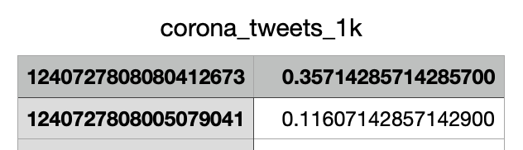
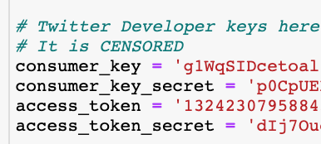
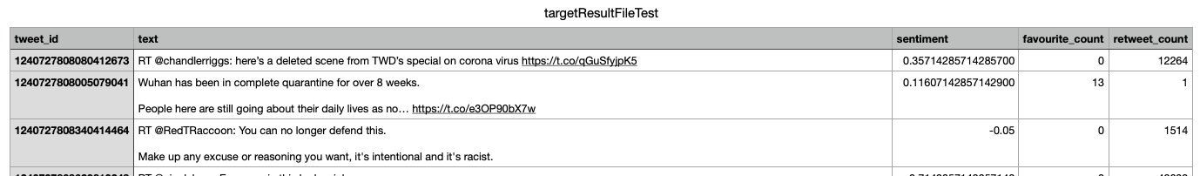
Data Extraction?
5
1
3
Load it to CSV and append the sentiment score from IEEE Dataset
Data from IEEE Dataport
Configure Tweepy API
2
4
Create Twitter Developer Account
With Tweet ID pull Twitter Data such as Tweet, Favorite Count, Retweet Count
6
The final CSV column is as below

Slide 5
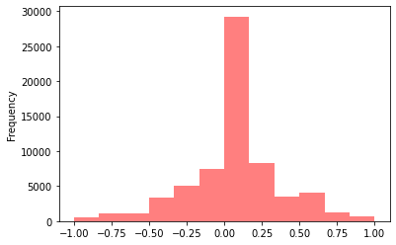
Data Analysis 1

Slide 6
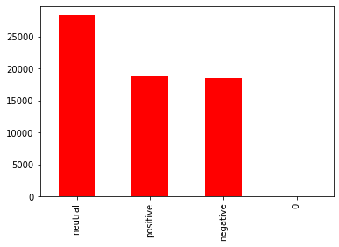
Data Analysis 2

Slide 7
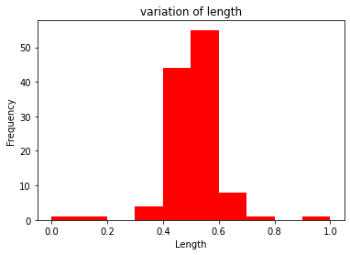
Data Analysis 3

Slide 8
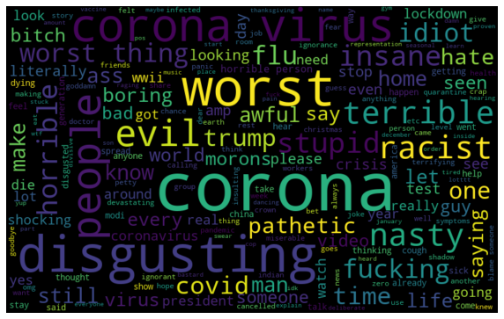
Negative Words in dataset

Slide 9
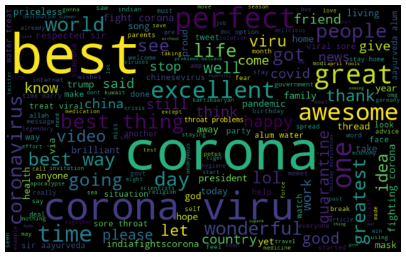
Positive Words in dataset

Slide 10
Data Preprocessing - NLP
1
4
Remove @
Lemmatization
2
5
Remove URL's and http
Stemming
3
6
Convert text to Lower case
Tokenization

Slide 11
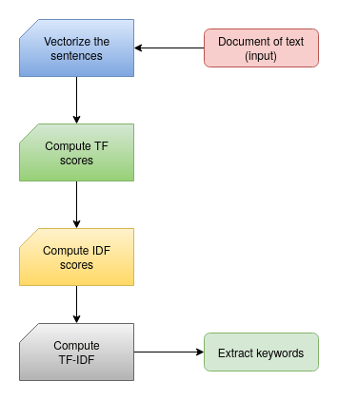
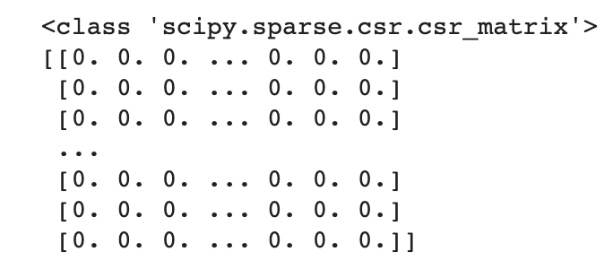
TFIDF
Parameters Used?
Max Feature = 1000 or 10000?
How to load the sparse matrix as Input into Neural Network or any models?

Slide 12
Linear Models
SVM
1
2
Naïve Bayes - Multinomial
3
Logistic Regression
Decision Tree
4

Slide 13
Deep Learning Models
LSTM
1
2
Fully Connected Neural Network

Slide 14
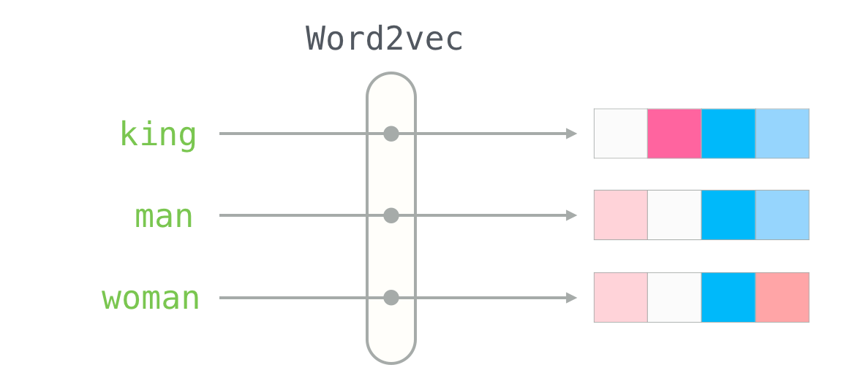
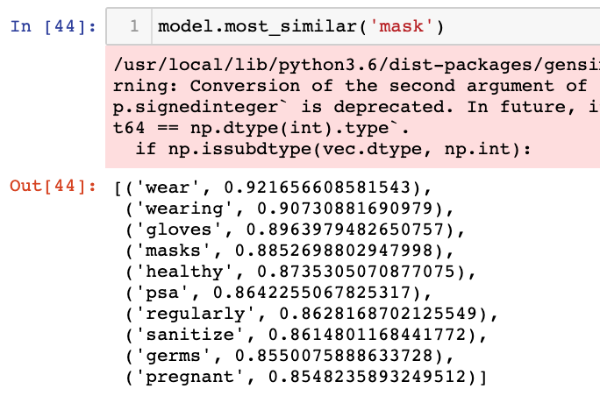
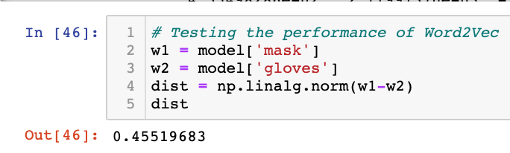
Word2Vec
Parameters Used?
SG = 0 (CBOW) or 1 (SkipGram)
Vector Size
Max Tweet Length
Window size

Slide 15
Linear Models
SVM
1
2
Naïve Bayes – Gaussian, Bernoulli
3
Logistic Regression
Decision Tree
4

Slide 16
Deep Learning Models
Convolution Neural Network
1
2
Fully Connected Neural Network

Slide 17

Best Models
TFIDF
Word2Vec
1. Logistic Regression
1. CNN
2. Naïve Bayes
3. Fully Connected Neural Network

Slide 18
What was the target accuracy score?
82.5
What is our model accuracy score?
86

Slide 19
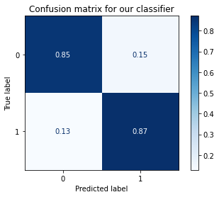
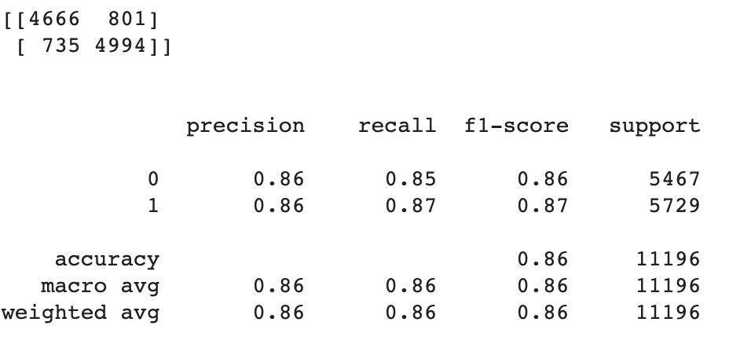
Logistic Regression - TFIDF

Slide 20
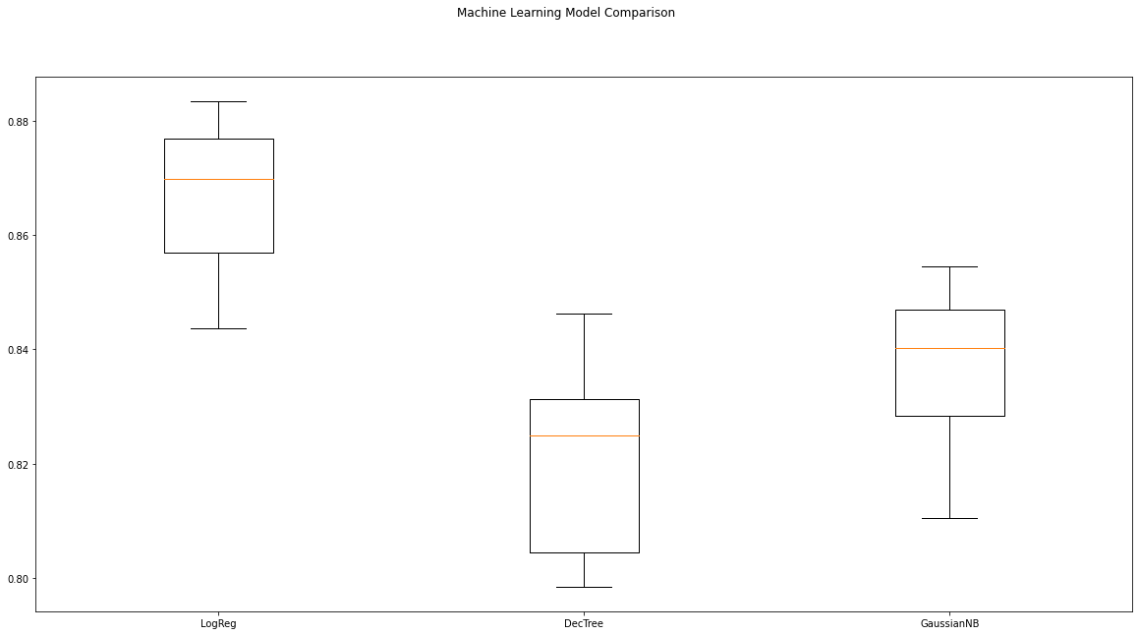
TFIDF Linear Model Comparison

Slide 21
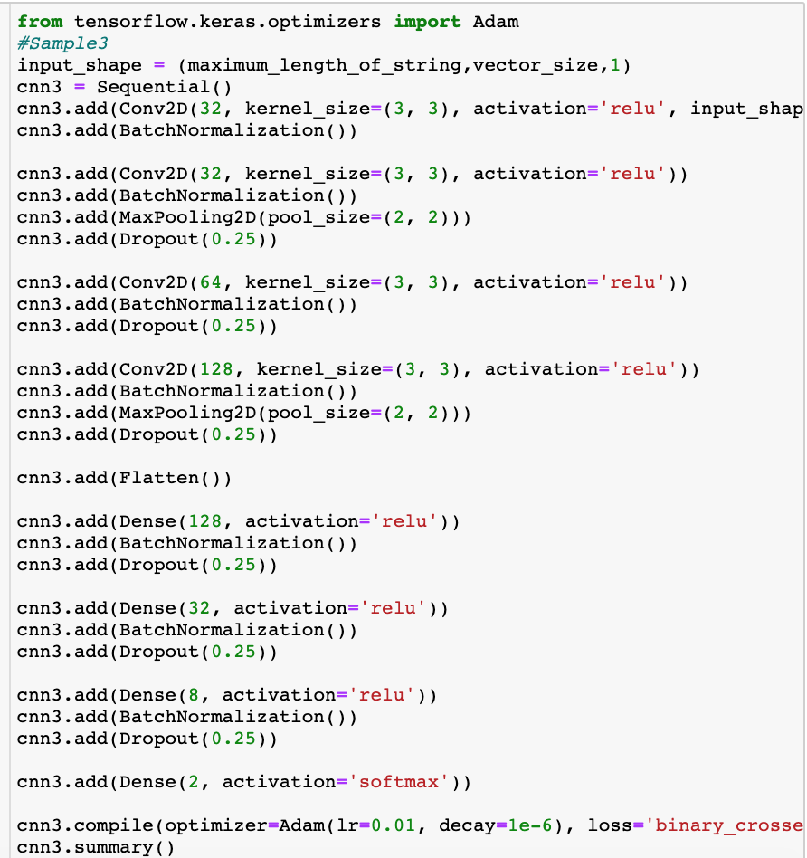
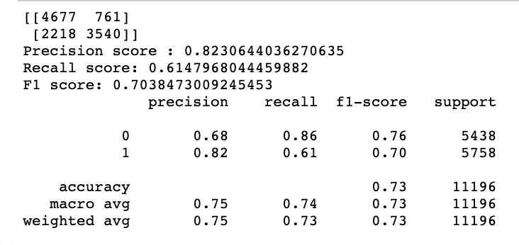
CNN Word2Vec

Slide 22
Additional Feature
What if this was a Regression Problem?

Slide 23
Challenges Faced 1
Duplicate Tweets in downloaded dataset!
How to Handle?

Slide 24
Challenges Faced 2
LSTM models not running on Collab?

Slide 25
Challenges Faced 3
How to load text data into a CNN model?

Slide 26
Challenges Faced 4
Models predicting good result for label 1/ Positive but not for 0/Negative ?

Slide 27
Project Take Away
Learned lot about NLP
Python Debugging Skills
Twitter Data Extraction

Slide 28
Future works
Treat this as a Regression Task and predict the sentiment score.
What if we give Favorite Count, Retweet count also to the model
What if we pull more details of different dates and try running the model.
Maybe using NLP Techniques like GloVe, Bert would improve our accuracy.

Slide 29
References

Slide 30
Thank you

